Slide 1
DIAMOND PRICE PREDICTION APPLICATION
STEPS FOR DEPLOYING APPLICATION ON HERUKO CLOUD PLATFORM FROM SCRATCH

Slide 2
INTRODUCTION TO HEROKU
Heroku is a cloud platform as a service (PaaS) supporting several programming languages.
One of the first cloud platforms, Heroku has been in development since June 2007, when it supported only the Ruby programming language, but now supports Java, Node.js, Scala, Clojure, Python, PHP, and Go.^{[3]}
For this reason, Heroku is said to be a polyglot platform as it has features for a developer to build, run and scale applications in a similar manner across most languages. Heroku was acquired by Salesforce in 2010 for $212 million.^{[4]}

Slide 3
STEP 1:
Along with your application files you need to take care of below mentioned steps:
1 You need all below mentioned files for deployment:
a. requirements.txt
b. Procfile
c. setup.sh(You need setup.sh only for streamlit)
2 Auto detect the app type.
3 git push & start running.

Slide 4
STEP 2:
Create a Python Virtual environment in command prompt.
pip list
Python –m venv\my_env
.\my_env\Scripts\activate (Activate virtual environment in windows)
Deactivate
Install these packages in virtual environment:
pip install matplotlib seaborn plotly sklearn nltk WordCloud
Create requirement.txt file using below mentioned command:
pip freeze > requirements.txt

Slide 5
STEP 3:
This part is required for NLP Projects
import nltk nltk.download(‘stopwords’} nltk.download('wordnet’)
Procfile(For Flask):
web: gunicorn app:project
web - Create a Web Dynos
gunicorn app - I want to run a gunicorn app. If multiple people use my app, gunicorn make sure of multi threading and processing app - code is in app.py
Procfile(For streamlit):
web: sh setup.sh && streamlit run project.py

Slide 6

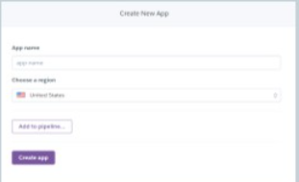
STEP 4:
First of all you have to create an account on Heroku.
www.Heroku.com
After Successfully creating account on Heroku, create new app.

Slide 7
STEP 5:
After creating new app go to command prompt and follow the commands given:
Install Heroku CLI and Git heroku login
Create a git repo and commit it locally
git init. git add* git commit –m “My First Commit”
heroku git:remote –a diamond-price--prediction—app (This IS NAME OF MY APP THAT I BUILT ON HEROKU) git push heroku master
RUN: heroku run bash -a diamond-price--prediction—app
STOP: heroku ps:scale web=0 -a diamond-price--prediction—app

Slide 8
STEP 6:
Your code will run and the link of your app will be generated:
My Application Link: https://diamond-price--prediction--app.herokuapp.com/
Successfully deployed on heroku cloud platform

Slide 9
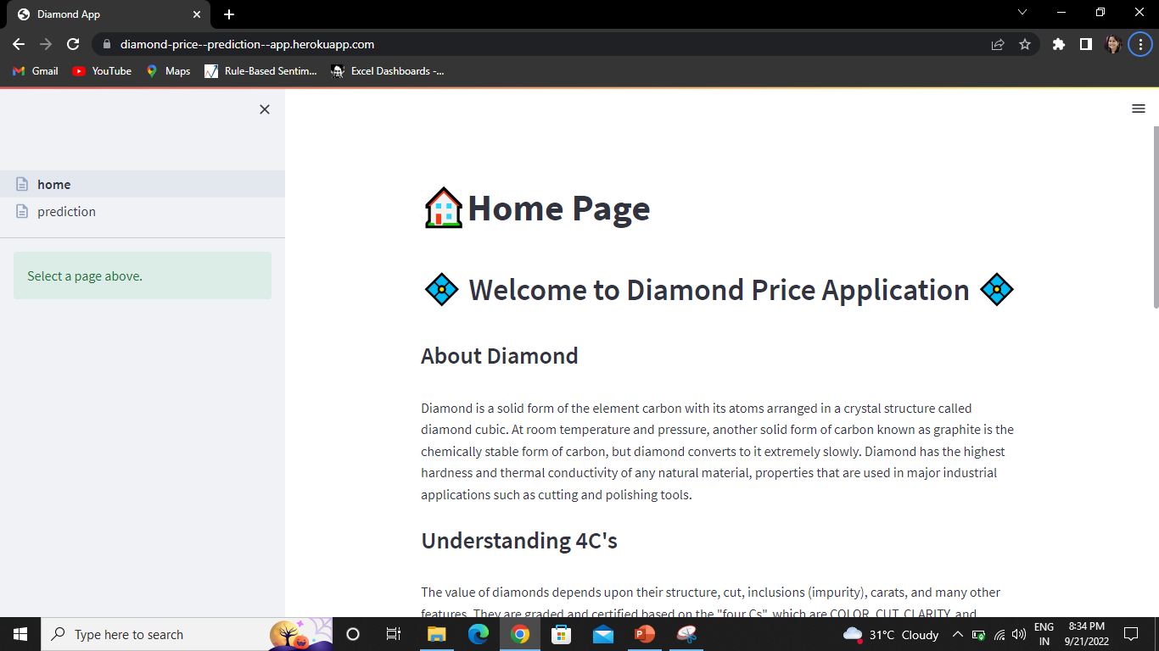
My web app looks like this

